Slide 1

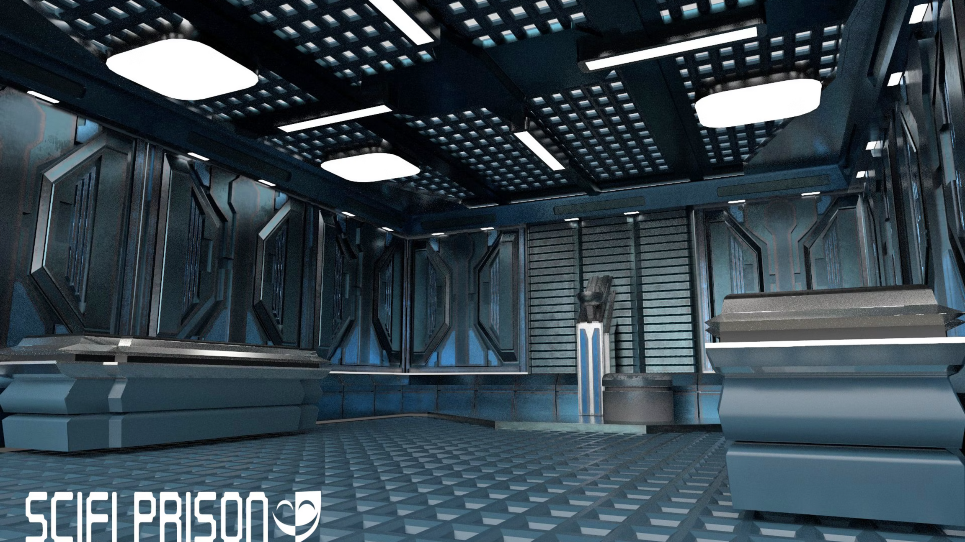
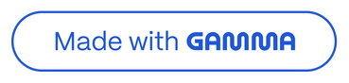
Prison Management System
Presented by:
Abdul Rehman
Abo Bakr Awan
Muhammad Hashim Abbas
Course: Data Structures
Submitted to: Madam Aisha Sattar Choudry

Slide 2
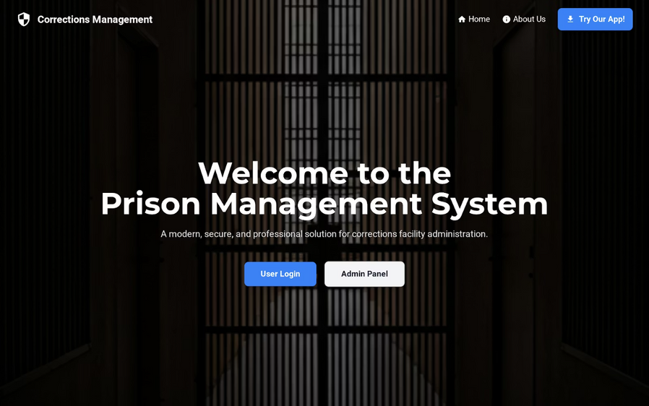
Introduction to the System
Our project introduces a robust console-based C++ application designed to revolutionise prison administration. It aims to replace outdated manual processes with a streamlined digital solution, significantly enhancing operational efficiency.
This system provides an efficient record management system for all aspects of prison life, from inmate details to visitor logs, ensuring precision and accessibility.

Slide 3
Addressing Critical Challenges
Current manual systems present several significant hurdles that our digital solution is designed to overcome.
Inefficient Manual Records
Difficult Data Retrieval
Reliance on paper-based records leads to bottlenecks, data loss, and delays in critical operations.
Locating specific information within vast physical archives is time-consuming and prone to errors.
Visitor Management Issues
ID Assignment Errors
Tracking visitor entries and exits, along with their associated records, is a complex and often flawed process.
Manual assignment of identification numbers can result in duplicates or inconsistencies, compromising security.

Slide 4
Project Objectives: Enhancing Prison Operations
Our Prison Management System is built upon a foundation of clear objectives, ensuring a comprehensive and impactful solution.
1
2
Digitise Prison Records
Manage Key Entities
To transition from paper to digital, creating a centralised and easily accessible database for all essential information.
To effectively track and manage details for prisoners, officers, cells, and visitors within a single integrated platform.
3
4
Ensure Data Consistency
Improve Operational Efficiency
To implement measures that maintain the accuracy and integrity of all stored data, preventing discrepancies.
To streamline daily tasks, reduce manual effort, and speed up administrative processes, freeing up resources.

Slide 5
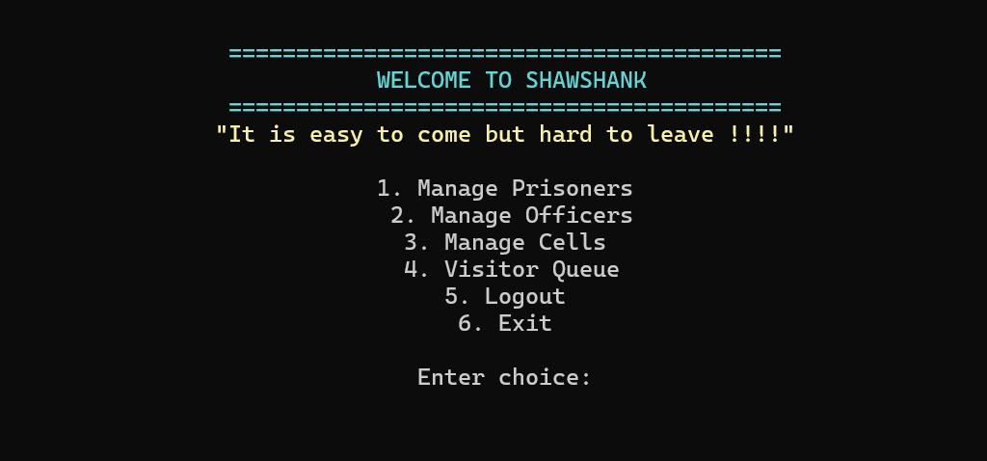
System Overview: Architecture and Design
The Prison Management System is engineered for user-friendliness and robust performance, integrating a carefully structured design to handle complex data efficiently.
Menu-driven Application: Intuitive interface for easy navigation and interaction.
Modular Design: Promotes scalability, maintainability, and easier future enhancements.
File-based Data Storage: Ensures data persistence and easy retrieval.
Secure Record Handling: Prioritises data integrity and confidentiality.

Slide 6



Core Data Structures
Our system leverages fundamental data structures to manage dynamic and interconnected prison data effectively.
Linked Lists
Stack
Queue
Used for dynamic record management of prisoners and visitors, allowing efficient additions and deletions.
Manages the reusability of prisoner IDs, ensuring no IDs are wasted and providing a LIFO approach for assignment.
Implements visitor management on a First-In-First-Out (FIFO) basis, ensuring fair and orderly processing of arrivals.

Slide 7
Essential Algorithms
The efficient functioning of our Prison Management System relies on these fundamental algorithms for data manipulation.
Linear Search
O(1) Head Insertion
Linked List Deletion
Applied for locating specific records efficiently across various modules, such as finding a prisoner by ID or a visitor by name.
Utilised for adding new records to linked lists, providing constant-time complexity for rapid data entry.
Employed for removing records from dynamic lists, ensuring proper memory management and data integrity when items are no longer needed.

Slide 8





System Workflow: A Guided Journey
The system guides users through a logical sequence of operations, from initial access to final data handling.
File Save & Exit
Persist data and close
Module Selection
Choose functional module
Main Menu
Select primary operation
Login
Authenticate user access
This structured workflow ensures clarity and ease of use, minimising potential errors during operation.

Slide 9
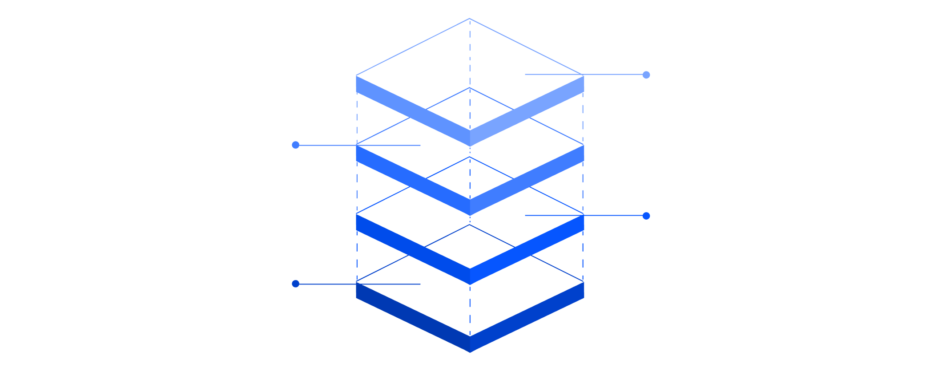
Database Design: Entity-Relationship Diagram (ERD)
Our ERD illustrates the relationships between key entities within the prison management system, forming the backbone of our data storage.
Visitor
PK visitor_id, prisoner_id (FK)
Officer
PK officer_id, assigned_cell_id (FK)
Cell
PK cell_id, capacity
Prisoner
PK prisoner_id, cell_id (FK)
This design ensures data integrity, minimises redundancy, and facilitates efficient querying and reporting.

Slide 10
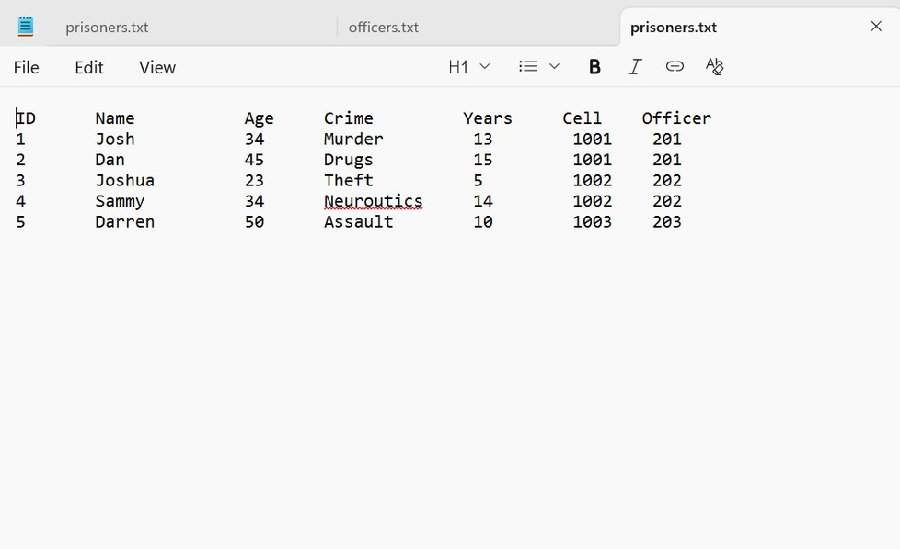
Robust File Handling
Effective file handling is paramount for the persistence and security of our prison management data. We utilise standard C++ file stream operations to manage information seamlessly.
Uses ifstream / ofstream: Standard C++ libraries for reading from and writing to files.
Data Stored in .txt Files: Simple, accessible format for storing structured data.
Load on Startup: All necessary data is loaded into memory when the application begins, ensuring a complete operational state.
Save Before Exit: Critical data is securely written back to files before the application terminates, preventing data loss.

Slide 11
Limitations and Future Improvements
Current Limitations
Future Enhancements
While effective, the current system has areas for growth:
Planned improvements to evolve the system include:
Console-Based Interface
Graphical User Interface (GUI)
Relies on a text-based interface, limiting user experience and visual feedback.
Develop a modern GUI for intuitive interaction and enhanced visual presentation of data.
File-Based Storage
Database Integration
Data stored in plain text files, posing scalability challenges and potential data integrity risks with concurrent access.
Migrate to a robust database (e.g., SQL) for improved data management, scalability, and security.
Basic Security Model
Advanced Features
Authentication is simple, lacking advanced access controls and encryption for sensitive data.
Implement modules for real-time tracking, comprehensive reporting, and multi-user support with role-based access.

Slide 12
Conclusion
The implementation of this Prison Management System marks a significant leap forward in correctional administration. By modernizing operations, we have laid the foundation for vastly improved efficiency and security across all facilities. This system actively reduces manual errors, streamlining processes from inmate intake to release, and empowers staff with better tools for comprehensive inmate management.
Looking ahead, this system is not just an upgrade; it's a strategic investment that will continue to evolve, enhancing public safety and enabling a more effective, humane correctional environment for the future. We are committed to leveraging technology to build safer communities and more transparent administrative practices.

